Slide 1
Paper
Structure Inference Net: Object Detection Using Scene-Level Context and Instance-Level Relationships, CVPR 2018.
Yong Liu1,2, Ruiping Wang1,2,3, Shiguang Shan1,2,3, Xilin Chen1,2,3
¹Key Laboratory of Intelligent Information Processing of Chinese Academy of Sciences (CAS)
²University of Chinese Academy of Sciences
³Cooperative Medianet Innovation Center

Slide 2
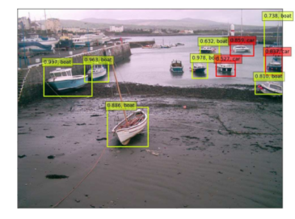
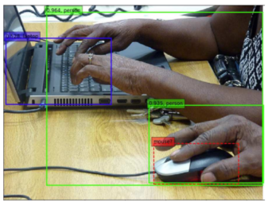
Problem
Contex for general object detection
Exsiting methods only consider scene-level context or instance-level context, never combine them
Scene-level context
Instance-level context
Notes:
Scene-level context: 所属的场景的信息，如图1的河流； Instance-level context: object relationship，如电脑和鼠标的关系

Slide 3
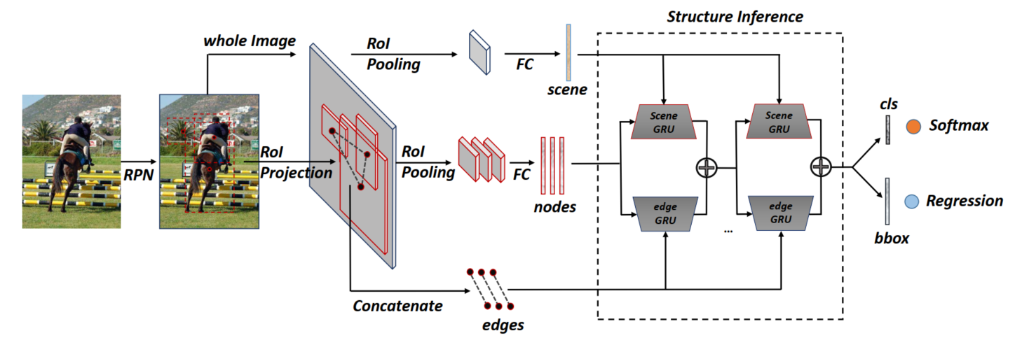
Contribution
We present a so-called Structure Inference Network (SIN), a detector that incorporates into a typical detection framework (e.g. Faster R-CNN) with a graphical model which aims to infer object state.

Slide 4
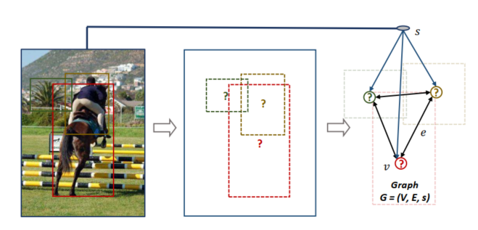
Idea
Use scene contextual information and object relationships to help detection.
Build graph for object feature and scene feature, use GRU to inference object state
Notes:
本质上是节点信息的传播，每个object节点从scene和其它object收集信息，来更新自己的feature

Slide 5
Method:How to build the graph
Node
Object feature: roi pooling of region proposal
Scene feature: feature of whole image

Slide 6
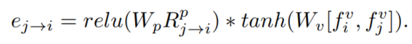
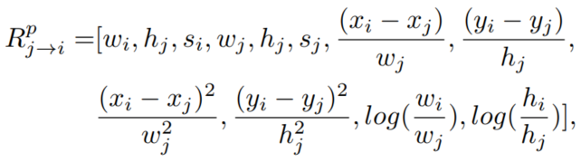
Method:How to build the graph
Edge
Assumption: object-object relationship is common determined by relative object position and visual clues
e_{j→i}: the influence of v_{j} on v_{i}
Notes:
si: area of bi; p: proposal

Slide 7
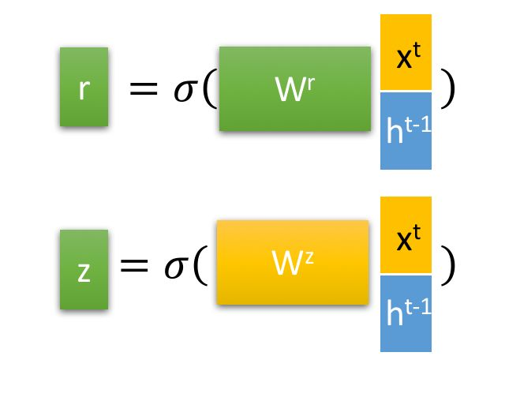
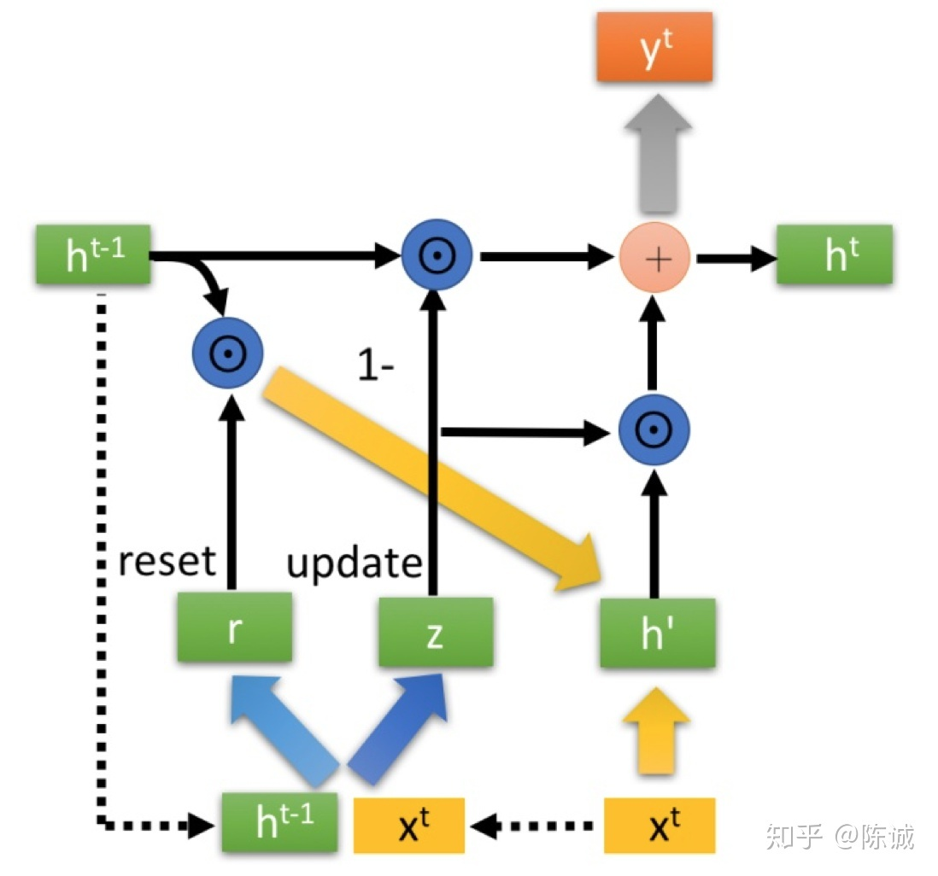
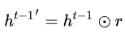
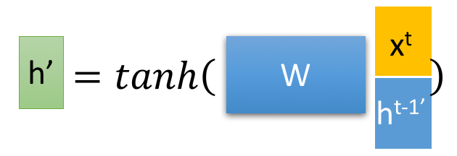
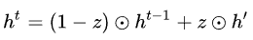
Method:Structure inference
GRU
=
z: remember current state
Notes:
ht-1: cell state，相当于长期记忆；h’: 衰减（reset)后的cell state，相当于近期记忆。GRU就是一个能选择性记忆当前事和清除记忆的组件。

Slide 8
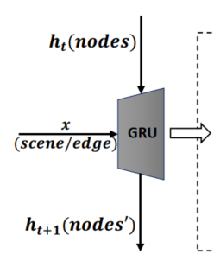
Method: Structure inference
Notes:
ht-1就是node feature，xt就是scene feature, feature info from other nodes

Slide 9
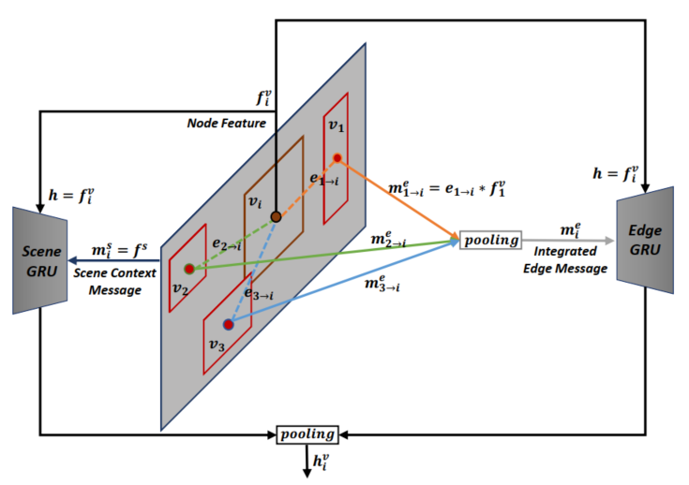
Method: Structure inference

Slide 10
Method: Structure inference
Scene GRU
Goal: encode message from scene
Ignore parts not related to the scene context
Ehance parts related to the scene context

Slide 11
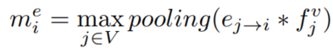
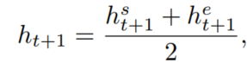
Method: Structure inference
Edge GRU
Goal: encode message from other objects
For each node i, get integrated message m_{i} from other nodes
Notes:
类似GNN简单聚合邻居节点信息

Slide 12
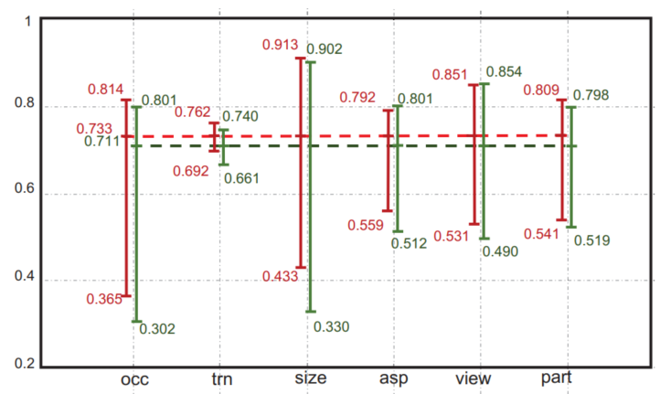
Ablation Study
Scene Module
Get great improvement in category: aeroplane, bird, boat, table, train, tv; high correlation with scene contex
Robust against occlusion, truncation, small, part
Notes:
truncation: 物体的一部分在图片外；part: 物体的part分类，如人的头部，手部

Slide 13
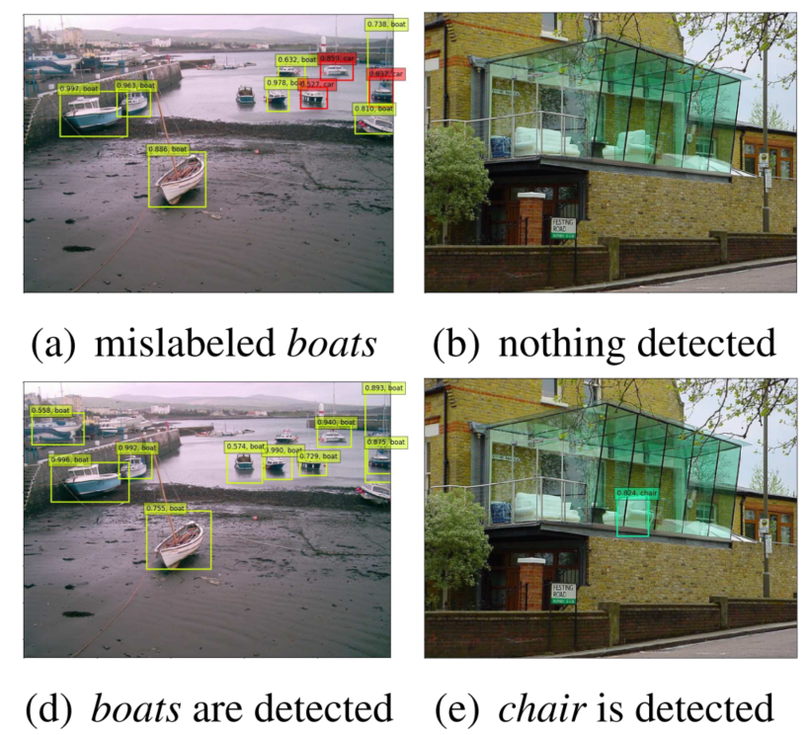
Ablation Study
Baseline: Faster RCNN
Structure Inference Net
Notes:
truncation: 物体的一部分在图片外；part: 物体的part分类，如人的头部，手部

Slide 14
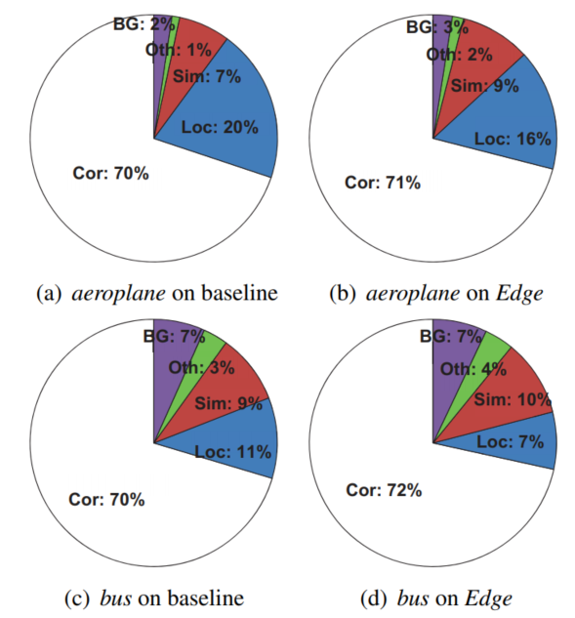
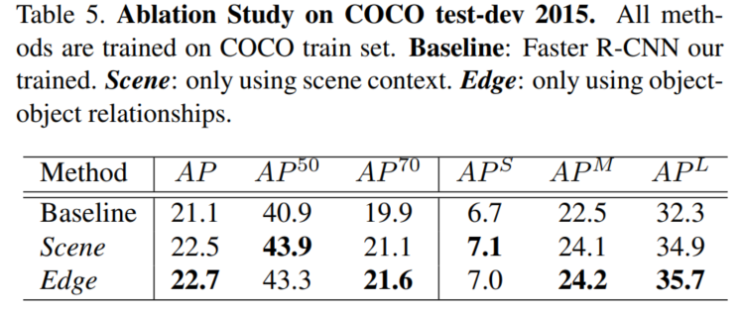
Ablation Study
Edge Module
More accurate localization
Notes:
AP70证明定位精度

Slide 15
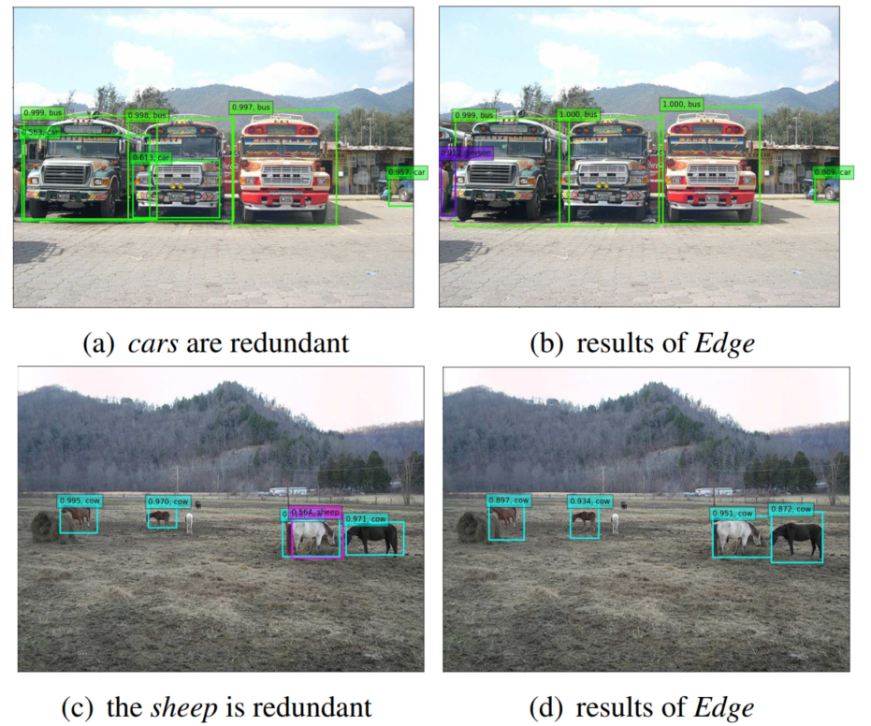
Ablation Study
Edge Module
less redundant predicted bboxes
Notes:
AP70证明定位精度

Slide 16
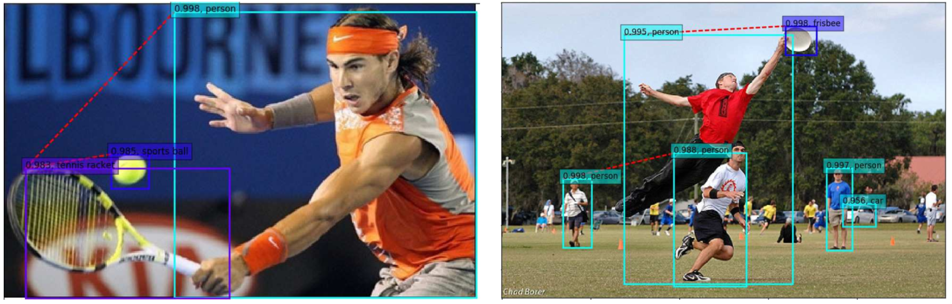
Ablation Study
Edge Module
Relation visualization
Notes:
AP70证明定位精度

